Slide 1
Promoting and Selling + Law in Society Revision
Multiple Choice

Slide 2
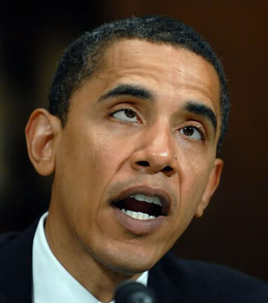
EASY LEVEL
Aim for 100%

Slide 3
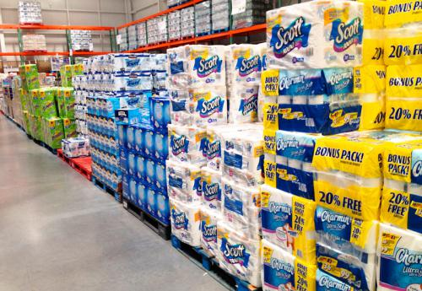
Question 1 – Which of the following are factors that differentiate products?
A) Convenience, Durability, Ethical, Cost
B) Service, Convenience, Environmental and Value
C) Ethical, Convenience, Environmental, Cost
D) Value, Promotion, Cost, Convenience

Slide 4
Question 2 – What is reason for NOT purchasing ‘ethical’ products over ‘average’ products?
A) They use natural materials and test them on animals
B) The food products are genetically modified
C) The products generally cost more
D) The profits go to NGO’s such as Fairtrade.

Slide 5
Question 3 – What is the best description for Advertising?
A) Informing, persuading or reminding customers about a product
B) A sales representative directly targeting a customer
C) Various strategies used in a promotional mix
D) A paid, non-personal message

Slide 6
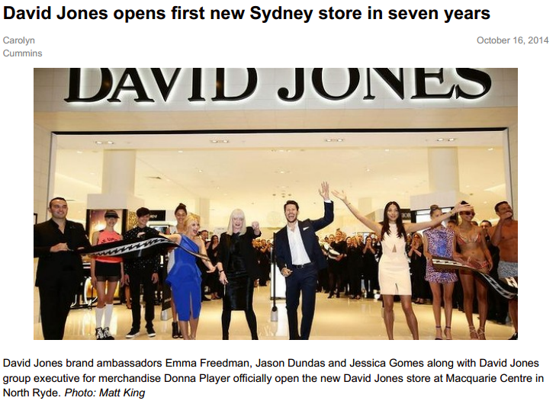
Question 4 – Look at the source below. What promotions strategy is being used?
A) Publicity
B) Public Relations
C) Premiums
D) Sales Promotion

Slide 7
Question 5 – Which of the following is an examples of a ‘sales promotion’ techniques?
A) Personal Selling
B) Samples
C) Loyalty Rewards Program
D) Premium

Slide 8
MEDIUM LEVEL
85%+

Slide 9
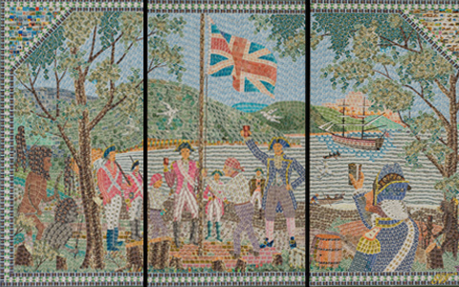
Question 6 – In what year did the colony of NSW become self-governing with the power to make its’ own laws?
A) 1788
B) 1828
C) 1901
D) 1967

Slide 10
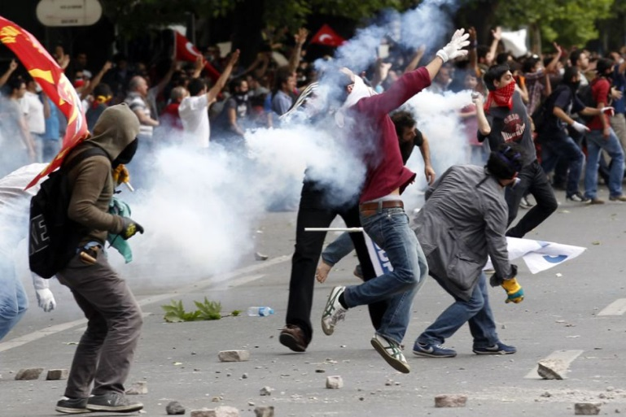
Question 7 – What are the three main roles of law in Australia?
A) Prevent anarchy, Punish and Rehabilitate
B) Protection, Freedom and Resolution
C) Restriction, Protection and Prevent anarchy
D) Maintain order, Protection and Punish

Slide 11
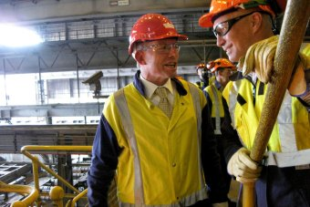
Question 8 – Which type of public law is concerned with the rights and obligations of employers and employees. ?
A) Tort
B) Contract
C) Administrative
D) Industrial

Slide 12
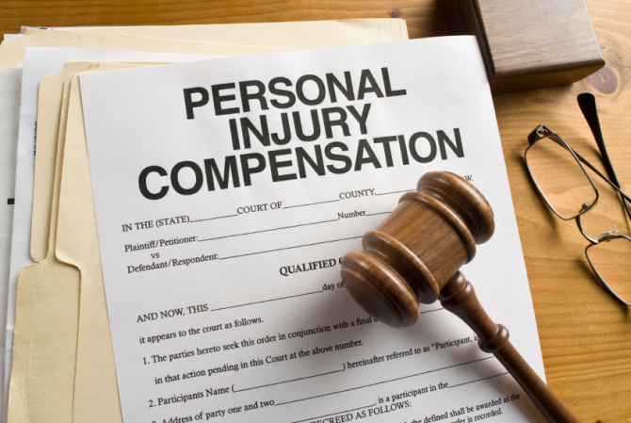
Question 9 – Negligence, nuisance and trespassing are all examples of Tort Law. What is the another example?
A) Compensation
B) Vandalism
C) Defamation
D) Protection

Slide 13
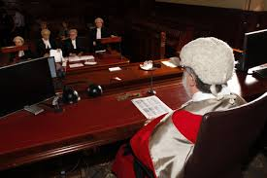
Question 10 – Who presides over the District court?
A) Judge
B) Jury
C) Magistrate
D) Lawyer

Slide 14
HARD LEVEL
70%+

Slide 15
Question 11 – The product below has a micro-market in mind to sell its product. What is this process known as?
A) Market Segmentation
B) Target Marketing
C) Secondary Marketing
D) Niche marketing

Slide 16
Question 12 – What is meant by the term “merchantable quality”?
A) ‘let the buyer beware’
B) Product is suitable for the purpose of being sold
C) The product is of a standard quality for a reasonable price
D) A product is claimed to have a certain characteristic.

Slide 17
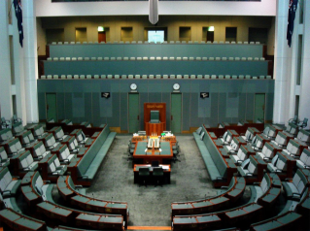
Question 13 – What is the 4th Step in the process of a bill becoming a law?
A) Second Reading in the House of Reps
B) Approval by the executive Council
C) First reading in the Senate
D) Third Vote in the House of Reps

Slide 18
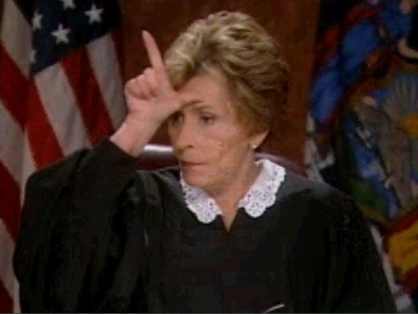
Question 14 – When Statute law cannot apply to a court case, what then must Judges rely upon to pass a verdict?
A) Balance of Probabilities
B) Precedents
C) Parliamentary Law
D) Common Law

Slide 19
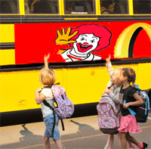
Question 15 – Which of the following misleading practices is NOT covered by the Trade Practices Act 1974 (Australian Consumer Law)
A) Fine Print
B) Special Offers
C) School sponsorship
D) Country of Origin

Slide 20
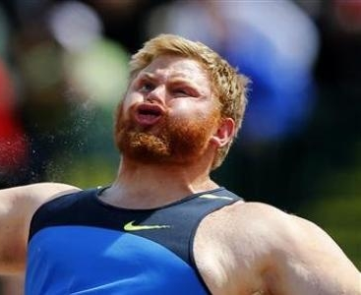
Really gotta like think and stuff LEVEL
50%+

Slide 21
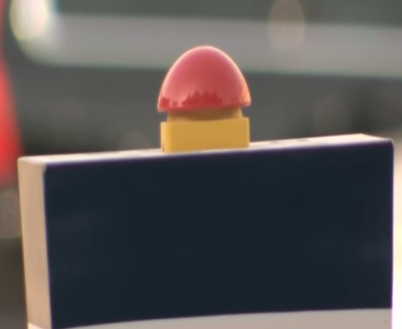
Question 16 – Watch the advertisement closely. What main promotion technique has successfully been used?
A) Gender Stereotypes/Sex Appeal
B) Publicity stunt
C) Mass marketing
D) Brand Logo/Large sign

Slide 22
Question 18 – What legal process occurs when the Plaintiff and Defendant can question juror members
A) Selecting A Jury
B) Empanelling a Jury
C) Electing a Jury
D) Challenging a Jury

Slide 23
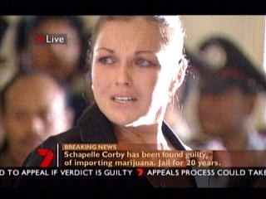
Question 19 – With respects to the law, which of the following BEST describes a person’s legal capacity to do something?
A) Gender
B) Location
C) Age
D) Socio-economic status

Slide 24
Question 20 – Identify the Company OR product by looking at the brand logo below?
A) Kia
B) Bit Tech
C) Target
D) Print

